Slide 1
A Survey of Semantic Web on Travel & Tourism Industry
By
Masoud Ehsani
Elnaz Shalbfian
Knowledge is having the right answer.
Intelligence is asking the right question.
~UNKNOWN
Supervisor: Prof. Saraee

Slide 2
Index
Introduction
Semantic Web
Tourism ontologies
Tourism Standards
Tourism information semantic modeling and querying
Search Engines
Overview
Search Engine: Markup formats
RDFa application in SEO
Future Work
References

Slide 3
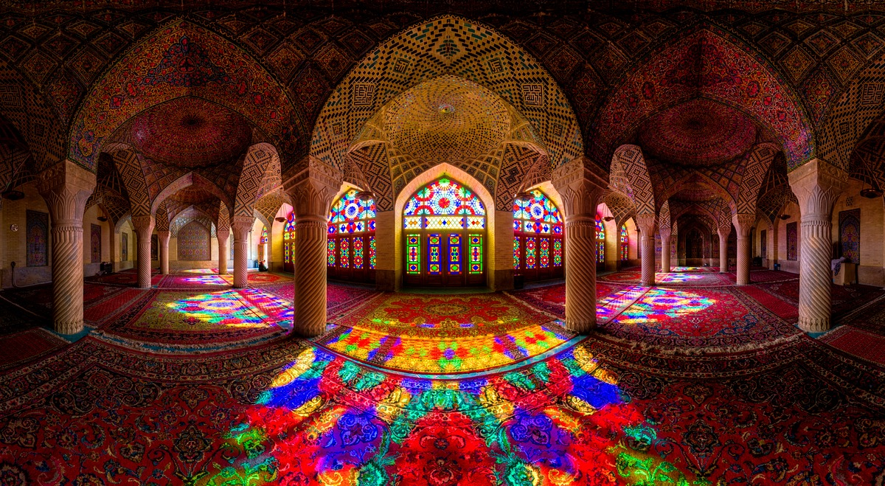
Introduction
Let’s organize a trip to Iran using the Web!

Slide 4
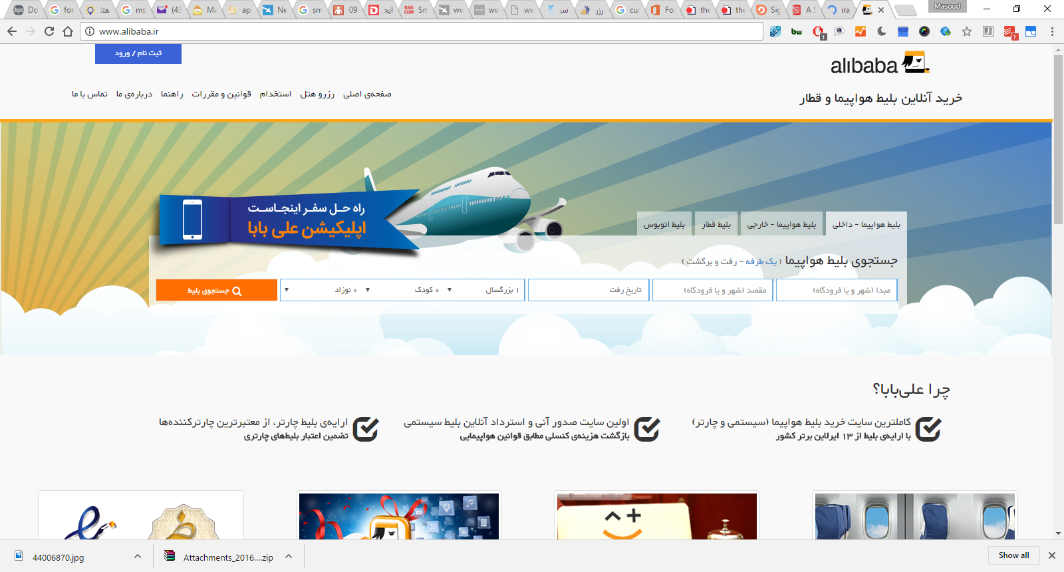
Introduction
You try to find a proper flight with …
oops, that is no good,
the page is in Perisan that
almost nobody
understands, but…

Slide 5
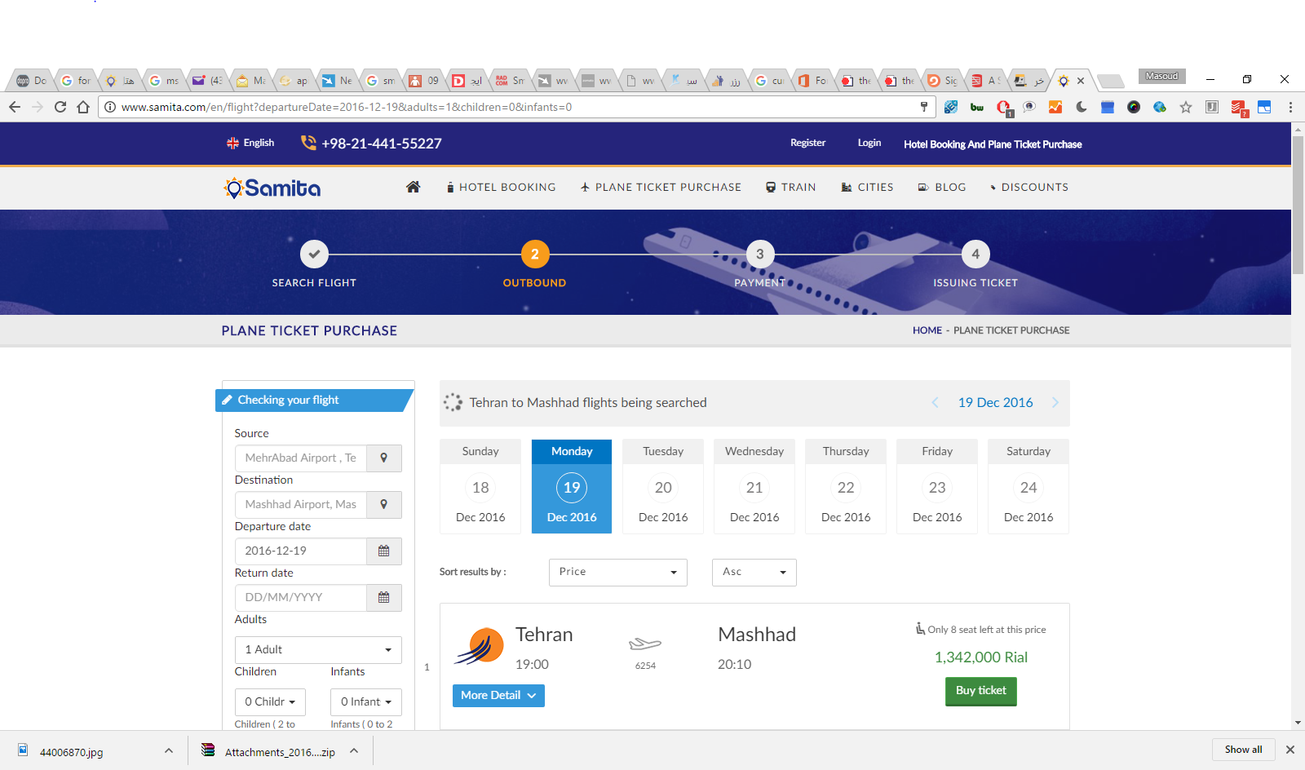
Introduction
… this one could work

Slide 6
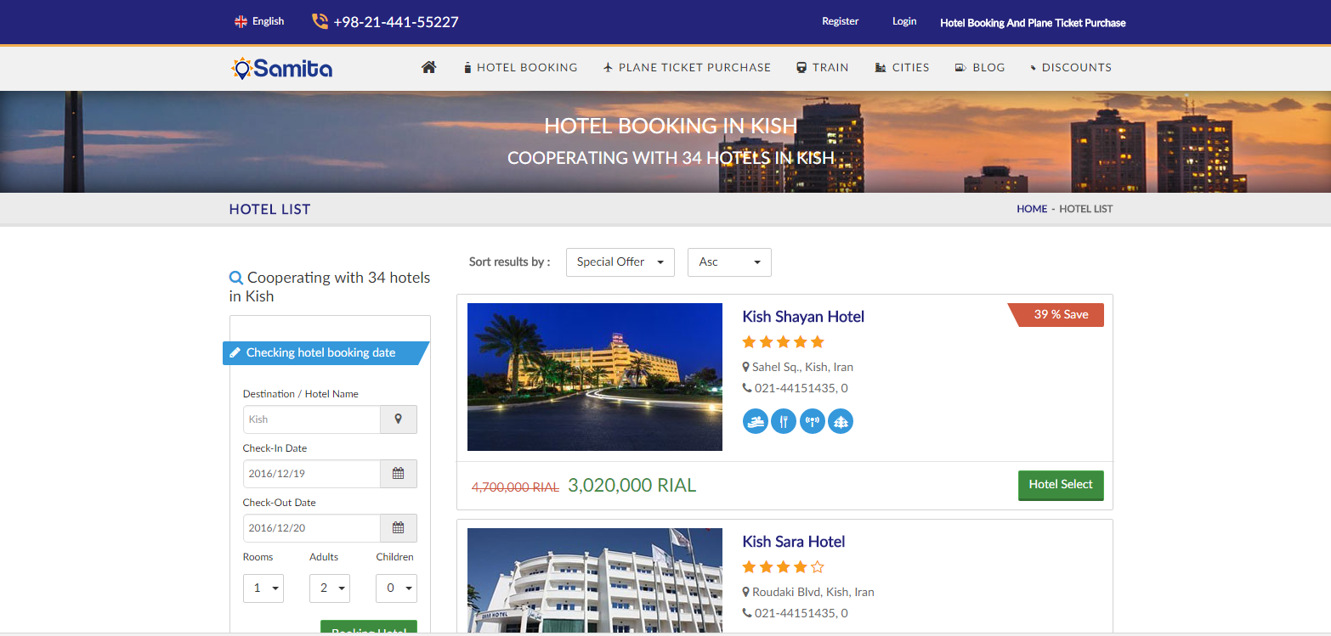
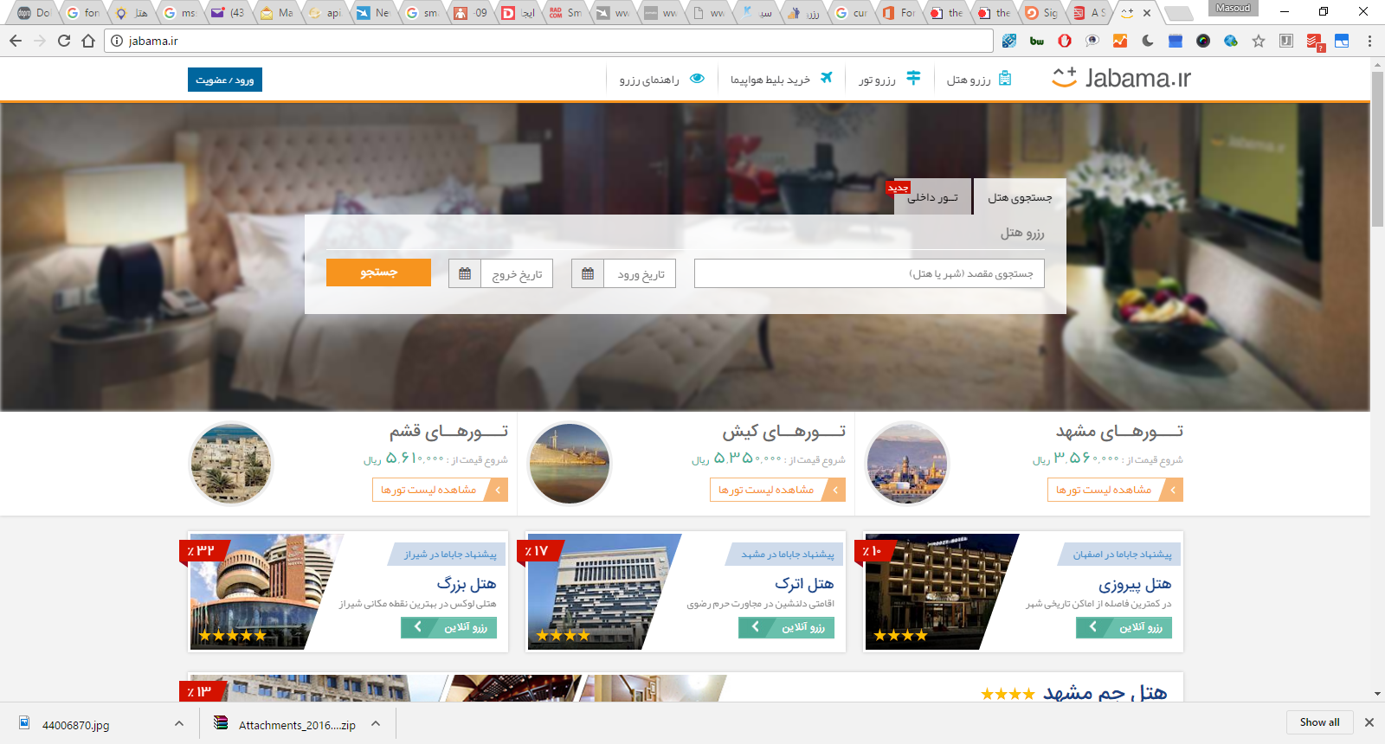
Introduction
You have to find a hotel, so you look for…

Slide 7
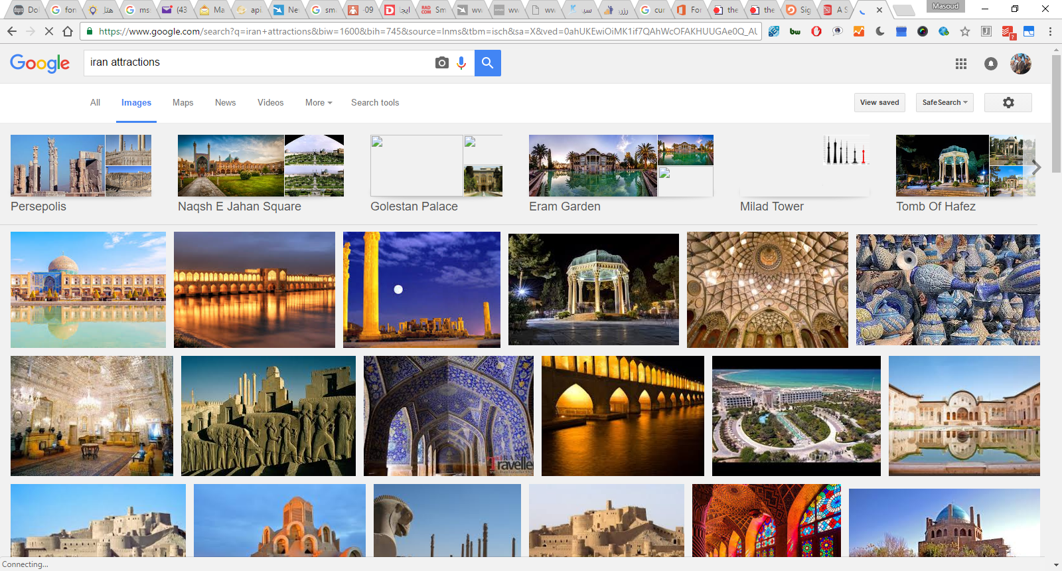
Introduction
You may want to know something about Iran; look for some photographs…

Slide 8
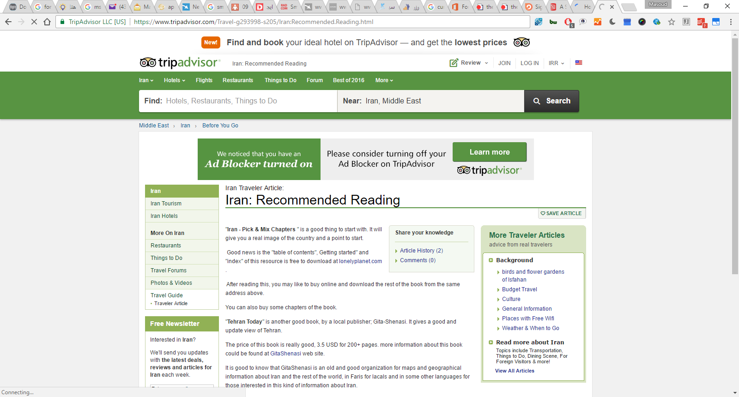
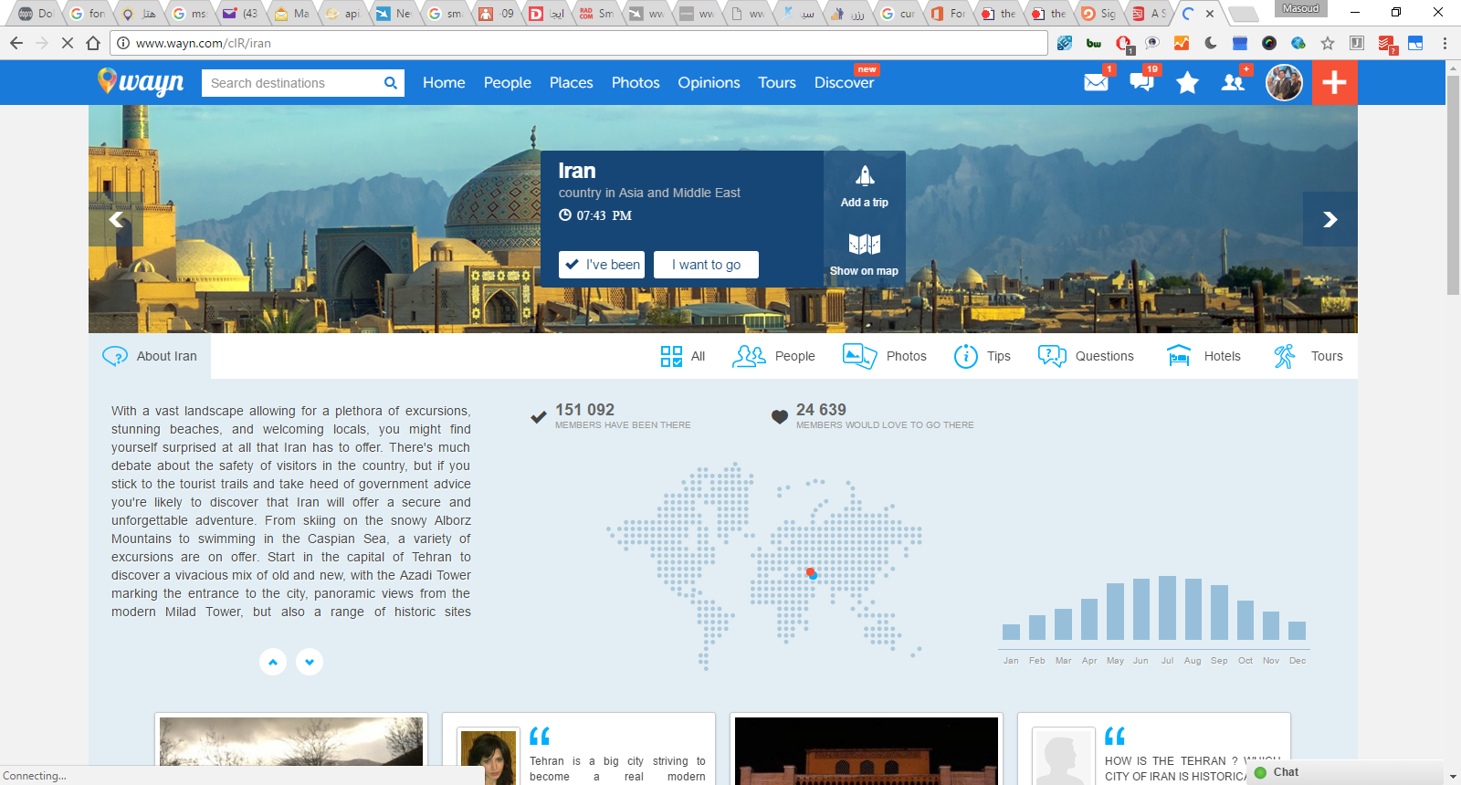
Introduction
Or check people reviews to plan your trip…

Slide 9

Introduction
What happened here?
You had to consult a large number of sites, all different in style, purpose, possibly language…
You had to mentally integrate all those information to achieve your goals
We all know that, sometimes, this is a long and tedious process!

Slide 10
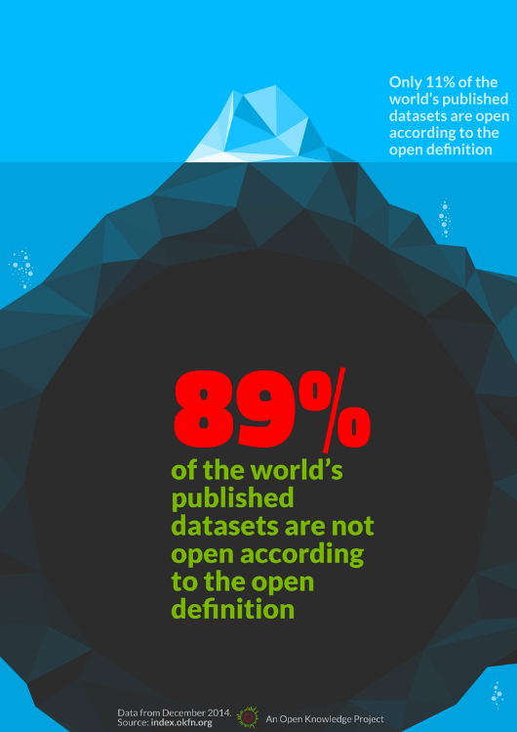
Introduction
All those pages are only tips of respective icebergs:
the real data is hidden somewhere in databases, XML files, Excel sheets, …
you have only access to what the Web page designers allow you to see

Slide 11
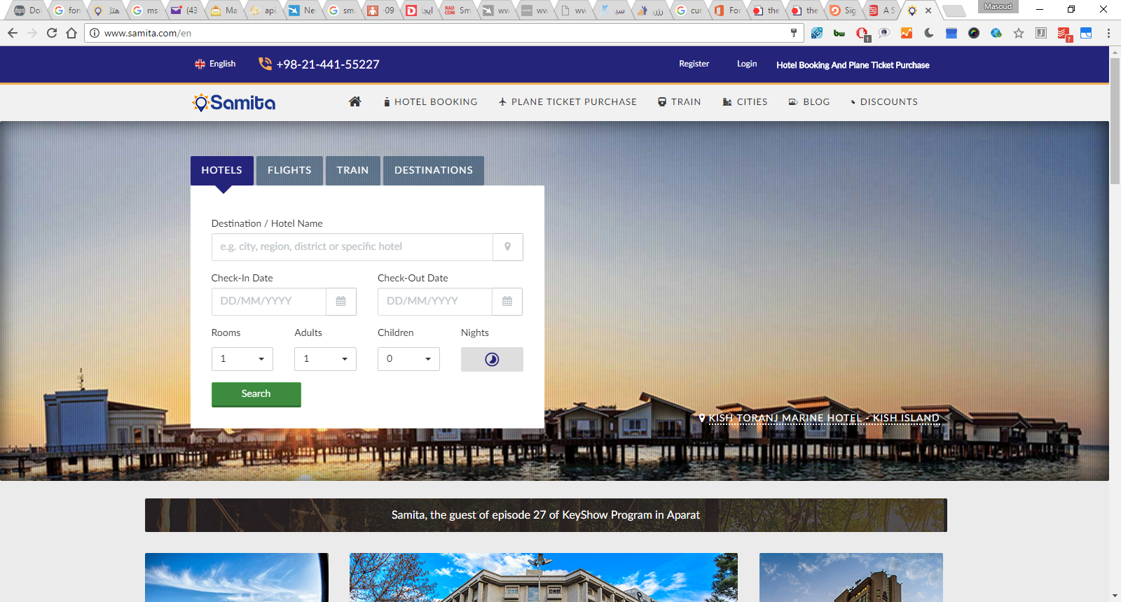
Introduction
But wait! Isn’t what mashup sites are already doing?
Specialized sites (Expedia, TripAdvisor, Samita) do a bit more:
they gather and combine data from other sources (usually with the approval of the data owners)
but they still control how you see those sources
But sometimes you want to personalize: access the original data and combine it yourself!

Slide 12
Introduction
What would we like to have?
Use the data on the Web the same way as we do with documents:
be able to link to data (independently of their presentation)
use that data the way I want (present it, mine it, etc)
agents, programs, scripts, etc, should be able to interpret part of that data
Put it another way…
We would like to extend the current Web to a “Web of data”:
allow for applications to exploit the data directly

Slide 13
Introduction
In some ways, yes, and that shows the huge power of what such Web of data provides
But mashup sites are forced to do very ad-hoc jobs
various data sources expose their data via Web Services
each with a different API, a different logic, different structure
these sites are forced to reinvent the wheel many times because there is no standard way of doing things
Put it another way (again)…
We would like to extend the current Web to a standard way for a “Web of data”

Slide 14
Introduction
But what does this mean?
What makes the current (document) Web work?
people create different documents
they give an address to it (ie, a URI) and make it accessible to others on the Web
Then some magic happens…
Others discover the site and they link to it
The more they link to it, the more important and well known the page becomes
remember, this is what, eg, Google exploits!
This is the “Network effect”: some pages become important, and others begin to rely on it even if the author did not expect it…

Slide 15
Introduction
On a Web of Data, something is missing; machines can’t make sense of the link alone
What we need for a Web of Data:
use URI-s to publish data, not only full documents
allow the data to link to other data
characterize/classify the data and the links (the “terms”) to convey some extra meaning
and use standards for all these!

Slide 16
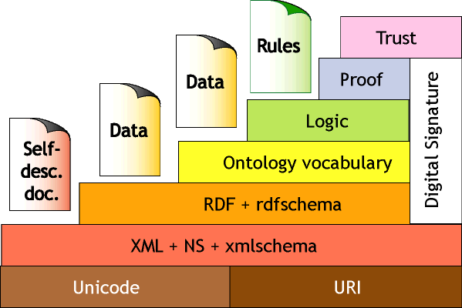







Introduction
So this is when the Semantic Web and its technologies is needed

Slide 17
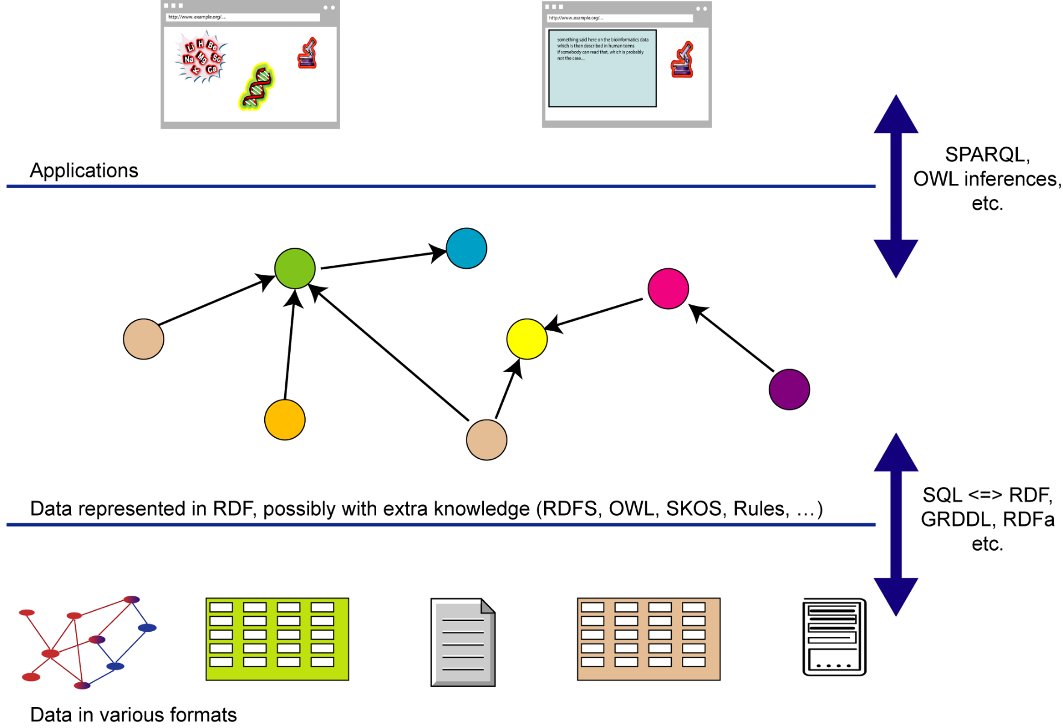
Introduction

Slide 18
Travel Ontology for Recommendation System based on Semantic Web
Search Engines

Slide 19
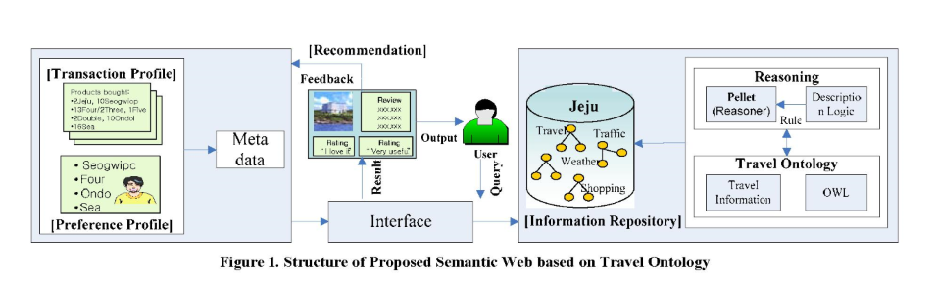

Slide 20
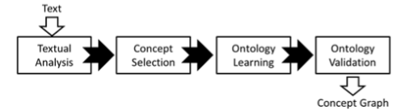
Tourism ontologies (Part 1)
Ontology Design for Thailand Travel Industry is a new approach to design ontology for Thailand travel industry on both general information and specific dynamic local information using Domain Ontology Graph (DOG) and location based services. As a result, this ontology design will be applied to an intelligent searching for making decision of tourists. This ontology design will be used in semantic tourism applications in the future.
Methodology on Ontology Learning
The content-based ontology learning process is applied to our design to enrich the ontology and its validation. The approach of this ontology design is based on the ontology learning process and the knowledge ontology modeling with four steps as shown in this Figure

Slide 21
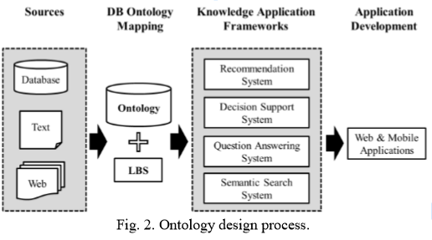
Tourism ontologies (Part 1)
This research will design the specific data of tourism in Thailand based on the collected static information and dynamic information. Target of the research is the travellers who use the internet for searching. This research will identify the context and extract domain by using reliable sources from Thailand, and will use location-based services to support general and specific information. In addition, we adopt 3 modules from the Knowledge Seeker system.

Slide 22
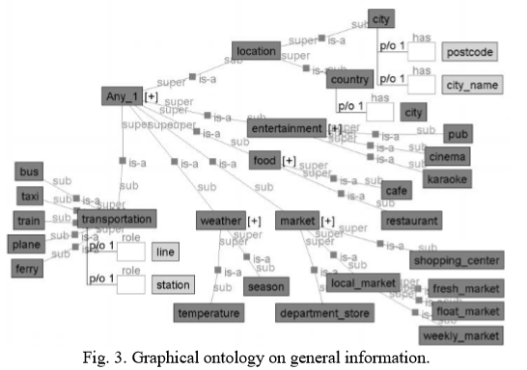
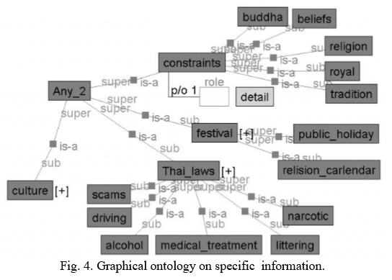
Tourism ontologies (Part 1)

Slide 23
Tourism ontologies (Part 2)
The OTA (OpenTravelAlliance) speciﬁcation deﬁnes XML Schema documents corresponding to events and activities in various travel sectors
The Harmonise ontology is specialised to address interoperability problems focusing on data exchange. Harmonise is based on mapping different tourism ontologies by using a mediating ontology. This central Harmonise ontology is represented in RDF and focuses mainly on tourism events and accommodation types.
The Hi-Touch ontology models tourism destinations and their associated documentations. The ontology classiﬁes tourist objects, which are linked together in a network by semantic relationships. The top-level classes of the Hi-Touch ontology are documents (any kind of documentation about a tourism product), objects (the tourism objects themselves) and publication (a document created from the results of a query).
The QALL-ME ontology provides a model to describe tourism destinations, sites, events and transportation [8] and aims at establishing a shared infrastructure for multilingual and multimodal question answering. The Tourpedia catalogue describes places (points, restaurants, accommodations and interests) related to different locations (Amsterdam, London, Paris, Rome, etc.)

Slide 24
Tourism ontologies (Part 3)
In the OnTour project, a working group at the Digital Enterprise Research Institute (DERI) deployed the e-Tourism ontology based on an international standard(the “Thesaurus on Tourism & Leisure Activities” of the World Tourism Organization (WTO, 2002)) using OWL (Web Ontology Language).. This ontology describes the domain of tourism and it focuses on accommodation and activities.
Mondeca’s tourism ontology (http://www.mondeca.com) defines tourism concepts based on the WTO thesaurus. These concepts include terms for tourism object profiling, tourism and cultural objects, tourism packages and tourism multimedia content.
COTRIN (Comprehensive Ontology for the Travel Industry) a comprehensive and precise reference ontology (Cardoso, 2004). The objective of COTRIN is the implementation of the semantic XML-based OTA specifications. Major airlines, hoteliers, car rental companies, leisure suppliers, travel agencies and others will use COTRIN to bring together autonomous and heterogeneous tourism web services, web processes, applications, data, and components residing in distributed environments.
The LA_DMS (Layered Adaptive semantic-based DMS and P2P) project deployed at the tourism destination ontology to enable destination management systems (DMS) adaptive to user’s needs concerning information about tourism destinations (Kanellopoulos et al., 2005).
The Satine project developed a secure semantics-based interoperability framework for exploiting web service platforms in conjunction with peer-to-peer (P2P) networks in the tourist industry (Dogac et al., 2004).

Slide 25
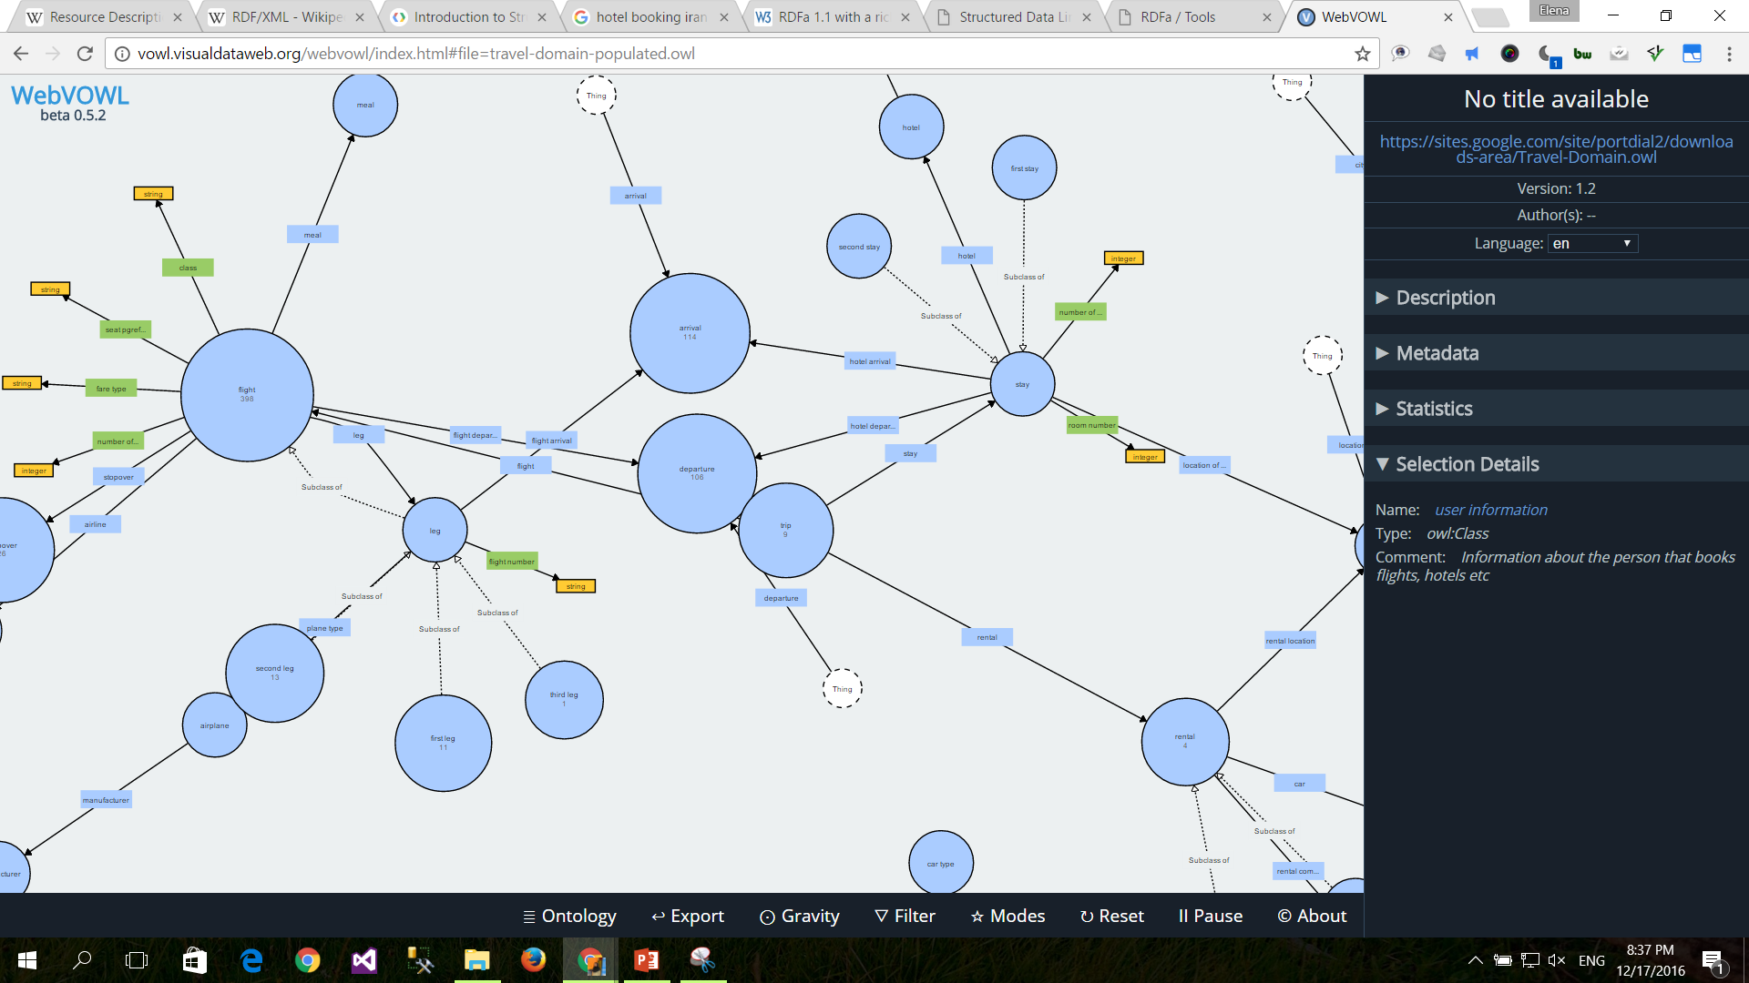
Tourism ontologies (Part 3)

Slide 26
Tourism Standards
The interoperability of Tourism Information Systems (TIS) is a major challenge for the development of tourism domain. Several national, European and international institutional initiatives have proposed different standards to meet the speciﬁc needs of tourism professionals.
TIF (Tour In France) evolved in 1999 in France to facilitate data exchange between different actors.
In 2004, the TourInFrance Technical Group (TIFTG) approved the new version of the standard, TIF V3. In this version, the standard has evolved towards XML technologies to facilitate publishing information on the Web and information exchange between systems, and is accompanied by several thesaurus. The last version of TIF can be downloaded from the following Web site: http://tourinfrance.free.fr/.

Slide 27
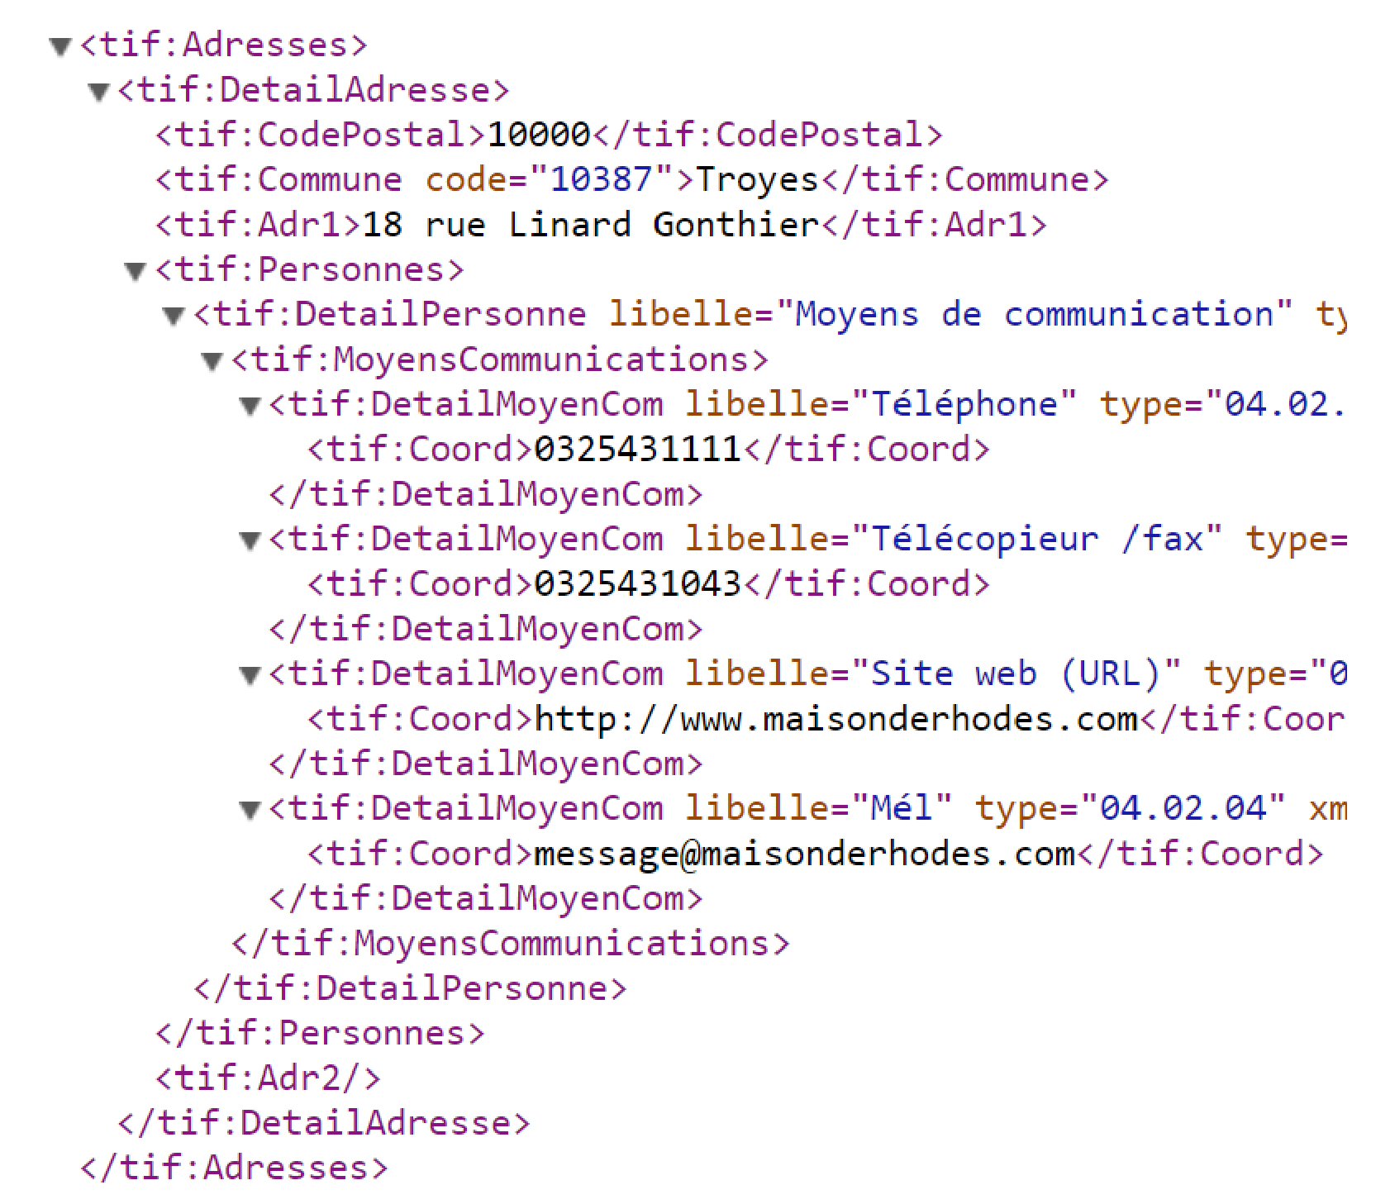
Sample syntax of TIF to describe an address (respect the standard TIF V3)

Slide 28
Tourism information semantic modeling and querying
Semantic annotation is the process of inserting tags in documents in order to assign semantics to the text.
The success of the semantic web in the tourism industry will depend on the availability of suitable ontologies as well as the proliferation of web pages annotated with metadata conforming to these ontologies.

Slide 29
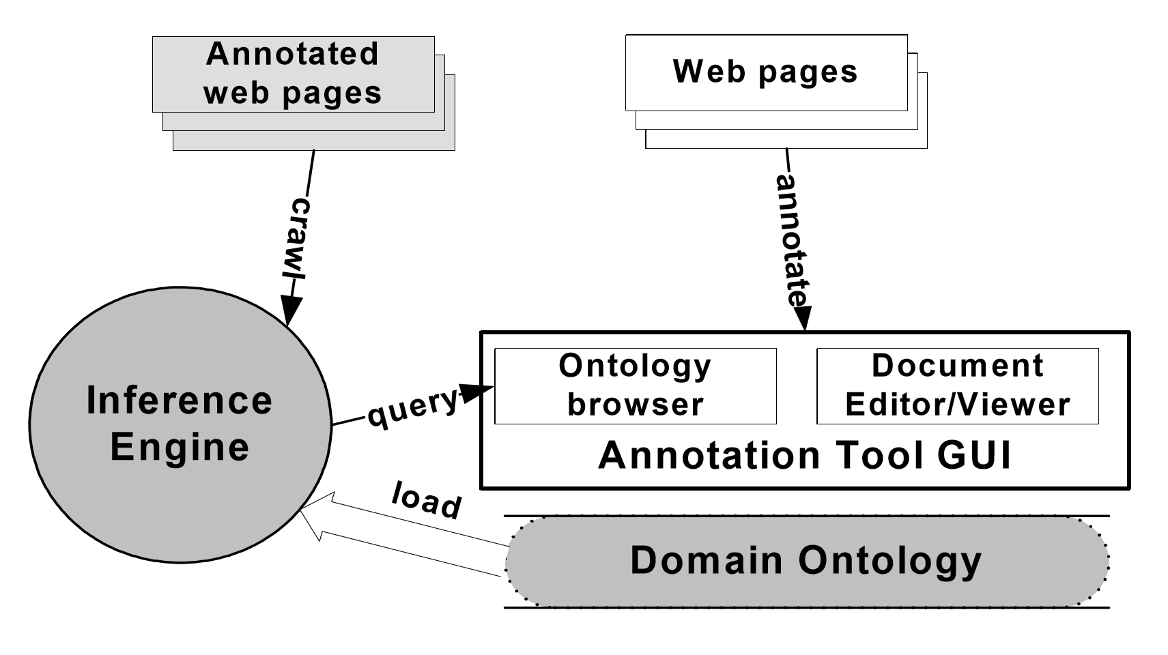
Architecture of Annotation Environment

Slide 30
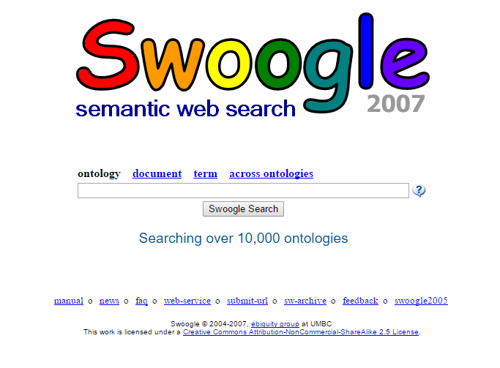
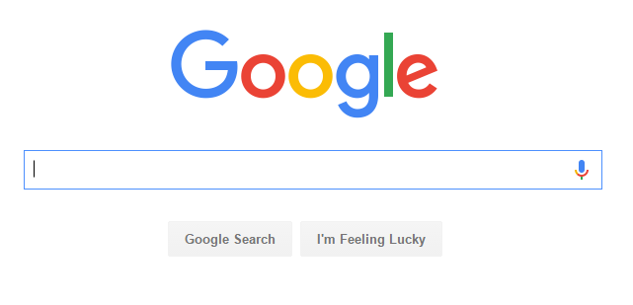
Search Engines
Search engines are an important tool for travelers to search for information about destinations. Google provides many services such as Google search, Google translate, and Google maps. Especially, Google maps offer street maps, street view, and satellite view, finding route and traffic status.
However these Google tools do not provide travelers special local dynamic information such as culture, law and festival constraints. Therefore, there is a need to develop more effective dynamic location based searching applications for travelers.
Ontology could be developed to serve as a dynamic semantic database to support the local information.

Slide 31
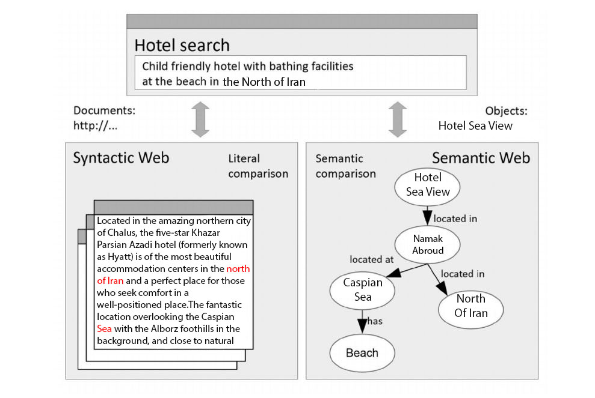
Semantic Vs. Syntactic

Slide 32
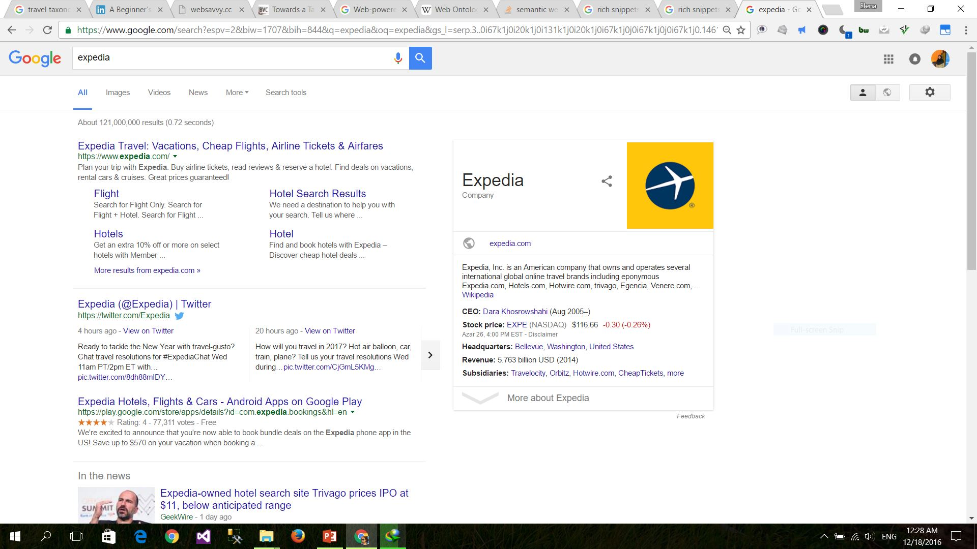
Sample Search Results

Slide 33
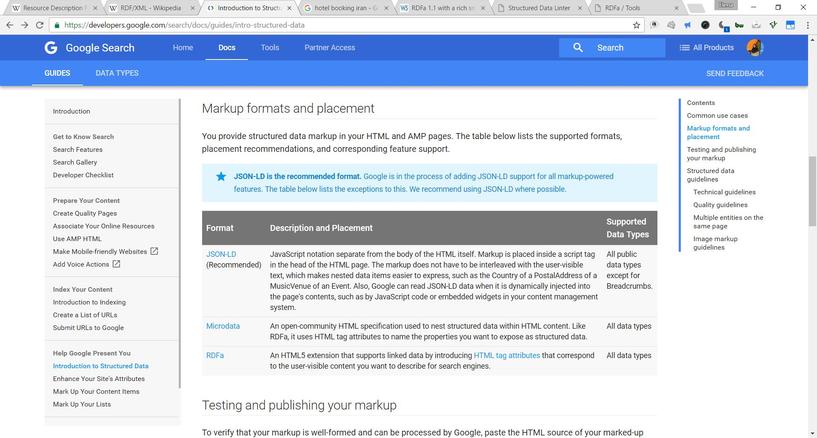
Search Engine: Markup formats

Slide 34
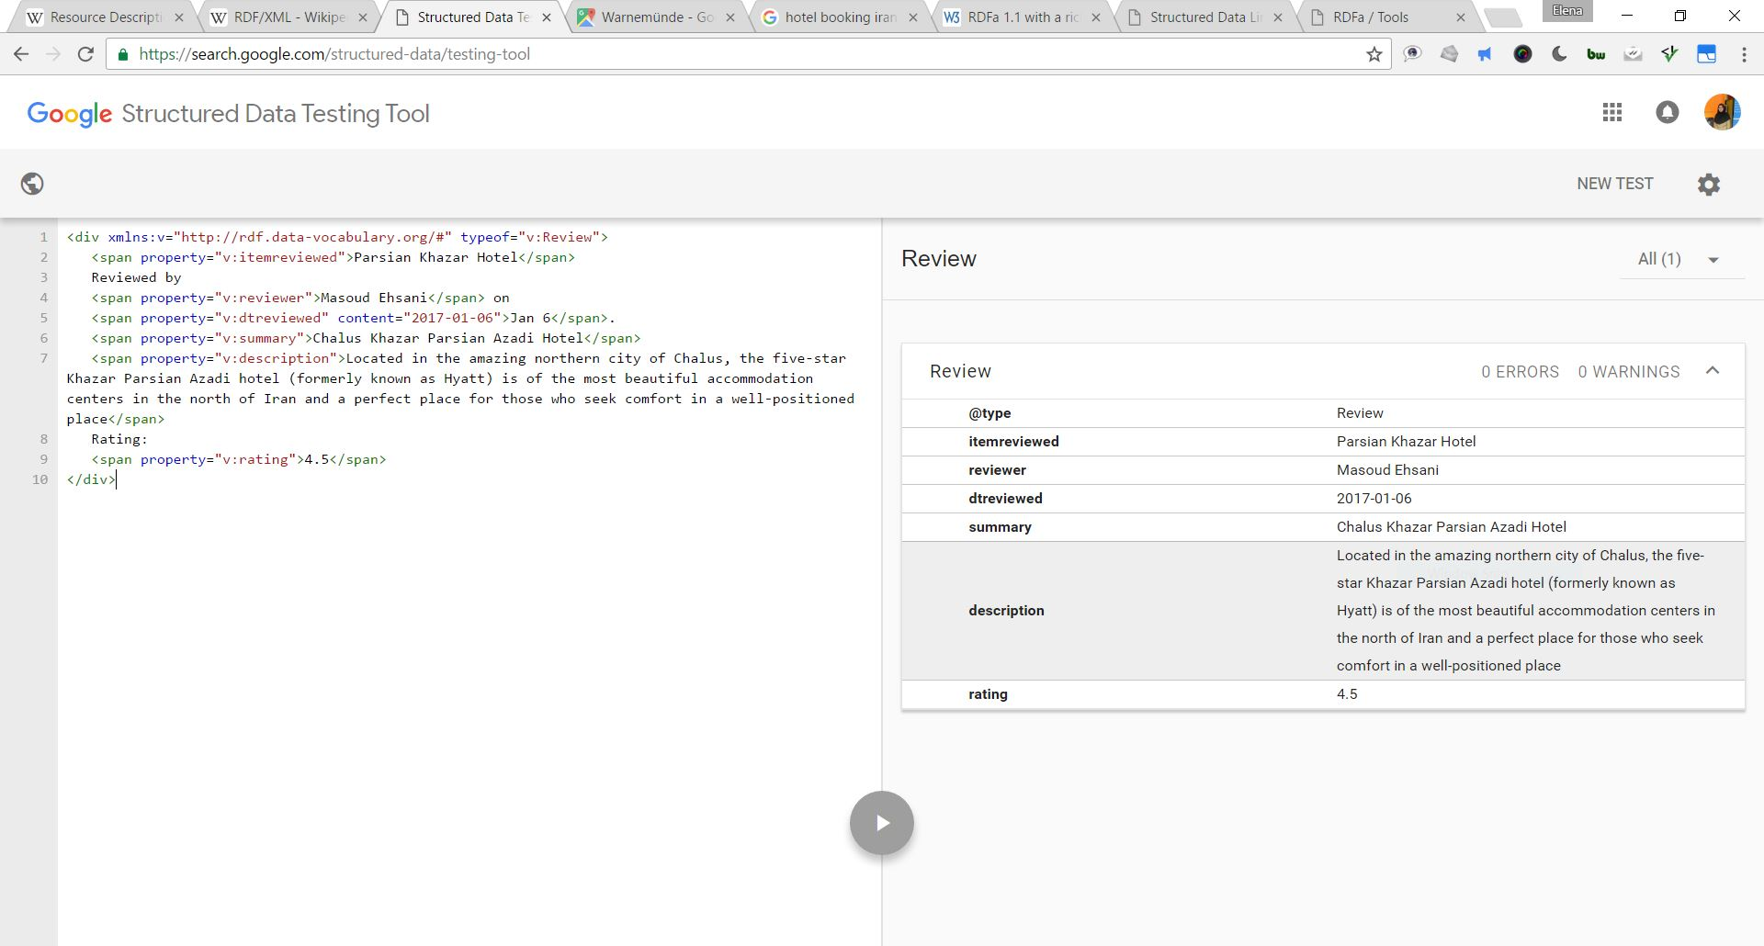
RDFa application in SEO

Slide 35
Future Work
Iranian Travel Ontology
Inferencing Ontology System
…

Slide 36
References
Alexander Maedchea, Steffen Staab, Applying Semantic Web Technologies for Tourism Information Systems
Fatima Faiza Ahmed, Fatima Saima hmed, Dynamic Tourism Information System using the Semantic Web, 2013
Dimitris N. Kanellopoulos, The Advent of Semantic Web in Tourism Information Systems, 2005
Introduction to the Semantic Web(tutorial)2009 Semantic Technology Conference, San Jose, California, USA June 15, 2009

Slide 37


